Slide 1

Swiss Re Overview
Contract Highlights
IMPM Process
- Dhruvi Doshi

Slide 2
Contents
Swiss Re overview
Contract overview
Incident Management
Problem Management

Slide 3
About Swiss Re:
2nd largest reinsurance company
Founded in 1863
Headquarter in Zurich, Switzerland
Acquired GE insurance in 2006.
CEO – Christian Mumenthaler

Slide 4
Contract Overview :
More than 10 years of relation with Capgemini(since 2000)
COMRS Model (Support Model) :
Consolidated Optimized Managed RUN Services
provide a single window of support for the applications in scope.
customer focus on outcome and service predictability rather than technology/ management and infrastructure.

Slide 5
L1.5 Team:
Triage team
Initial analysis based on Run Book
Communicate with user and give necessary update
Contact L2/L3 team in case no solution/workaround found
L2 Team:
Owner of the incidents
Ticket clock will start when it comes to L2 team
Don’t have access with codebase
Further analysis and resolution

Slide 6
L3 Team:
Detailed analysis and do changes in code if needed
Once application manager approved, do changes in the application
L1.5 and L2 team need to give support on respective time-
8:00 IST to 18:00 CST (22*5 hours)

Slide 7
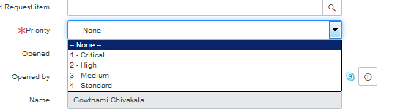
Incident Management:
Any kind of interruption in IT service and reduction quality of product
Triage team validates ticket based on CI, priority and incident type
Priority of ticket:
Critical
High
Medium
Standard

Slide 8
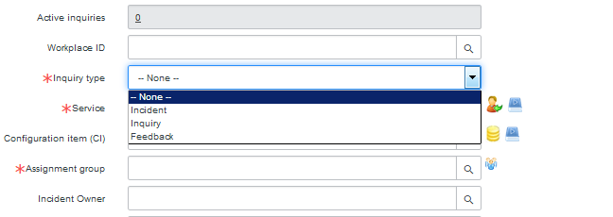
Incident type:
Incident
Inquiry
Feedback

Slide 9
Agreements with customer:
Response time
Resolution time (based on type of application and priority of ticket)
Reopen time
Wall time
CSTA
3 types of application:
Gold
Platinum
Silver

Slide 10
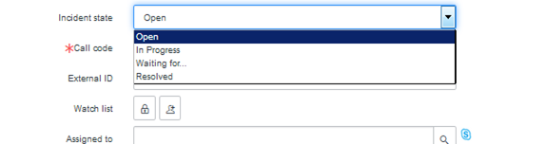
Status of ticket:
Open
In progress
Waiting for customer
Waiting for dependency
In analysis
Resolved
Closed

Slide 11
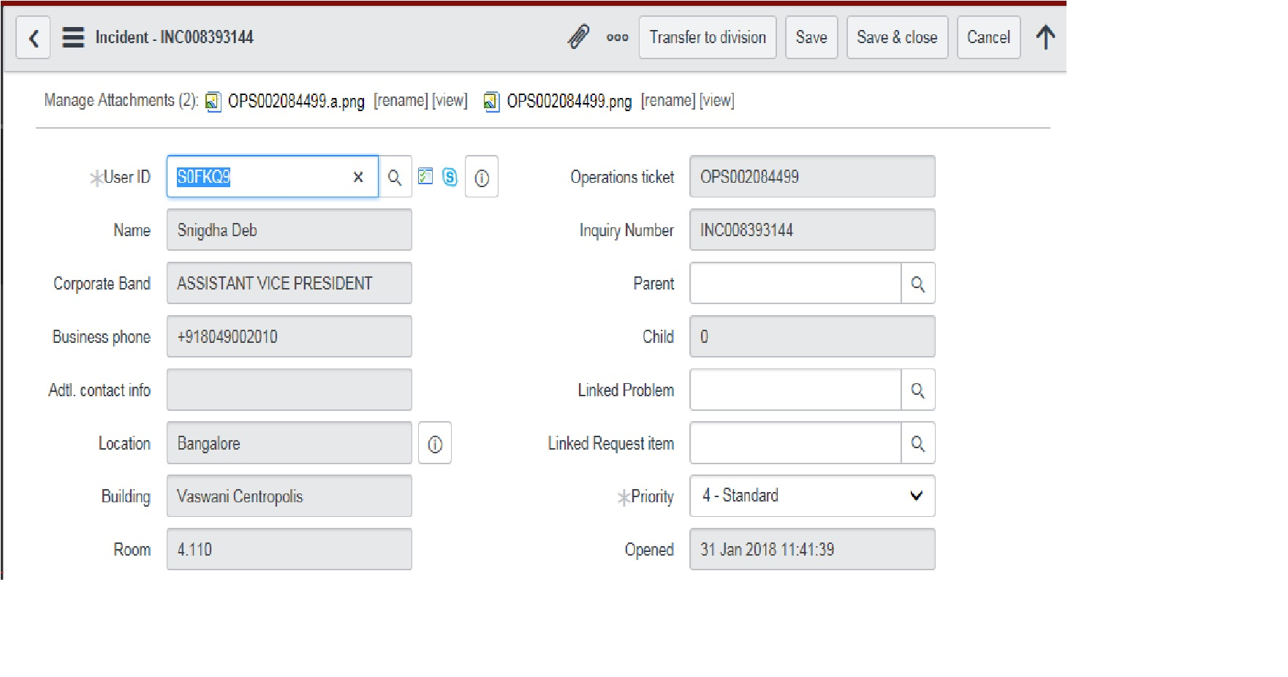

Slide 12
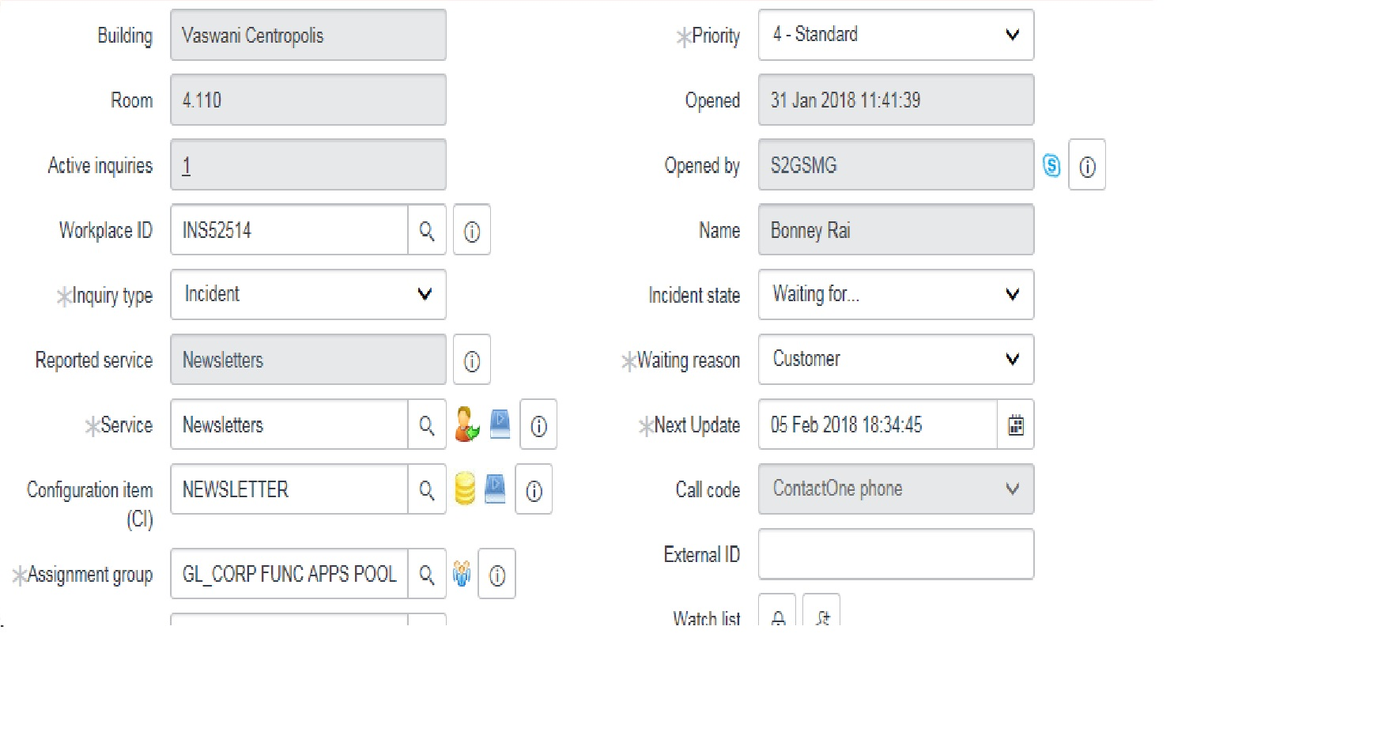

Slide 13
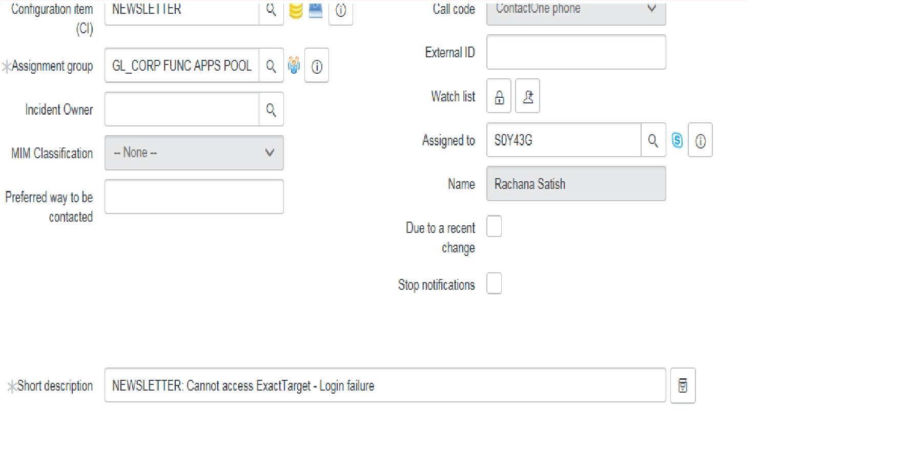

Slide 14
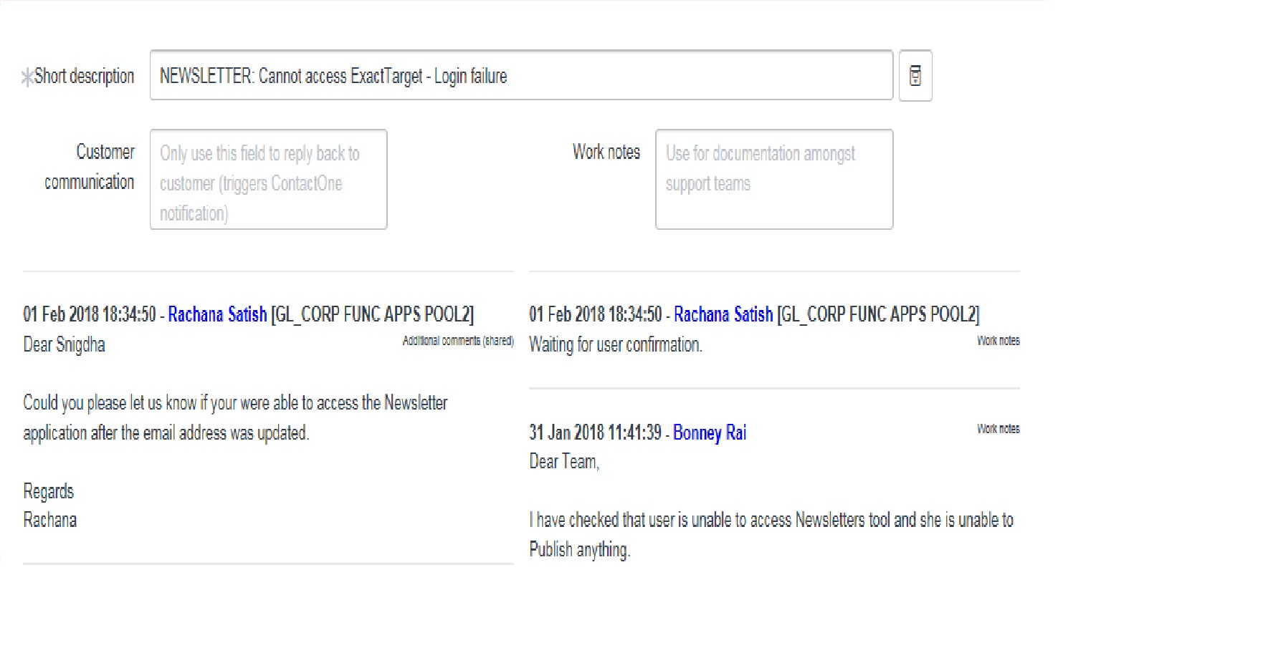

Slide 15
Problem Management:
Due to problem in interface , interruption or disturbance in application
Reasons :
Issue in the product
Same kind of ticket by different users
No root cause found
Permanent fixing
Two types of problem ticket:
Preactive
Reactive

Slide 16
Steps for creating problem ticket:
It is automatically generated
Four status:
Open
In analysis
Waiting for change
Resolved
Impact
Urgency
Short description (with prefix code)
Root cause
Work notes

Slide 17
In case of CR :
Link the CR no to problem ticket
Watch list
3rd party relevant
External id
Status:
fixed
Tested successfully
Retest failed
Fixed for future release

Slide 18
Raised and delivered release
After you get resolution:
Permanent resolution
Do not purchase further
Update the KB article

Slide 19
Thank You

